Slide 1

Probability distributions
DATA ANALYTICS | IRONHACK
P(tmrw weather == sunny)= 0.3
Probability: 0.3 in [0,1]
Random variable: weather
State: sunny —> discrete variable because the state space is
{sunny, not_sunny}
X —> Classification (LR, …)
P(temperature tmrw in Berlin is 30C)= 0.01
Random variable: tmp
State space: \RR+=[o, infty) → rv is a continuous rv
X —---> Regression
? how we calculate the probabilities?

Slide 2

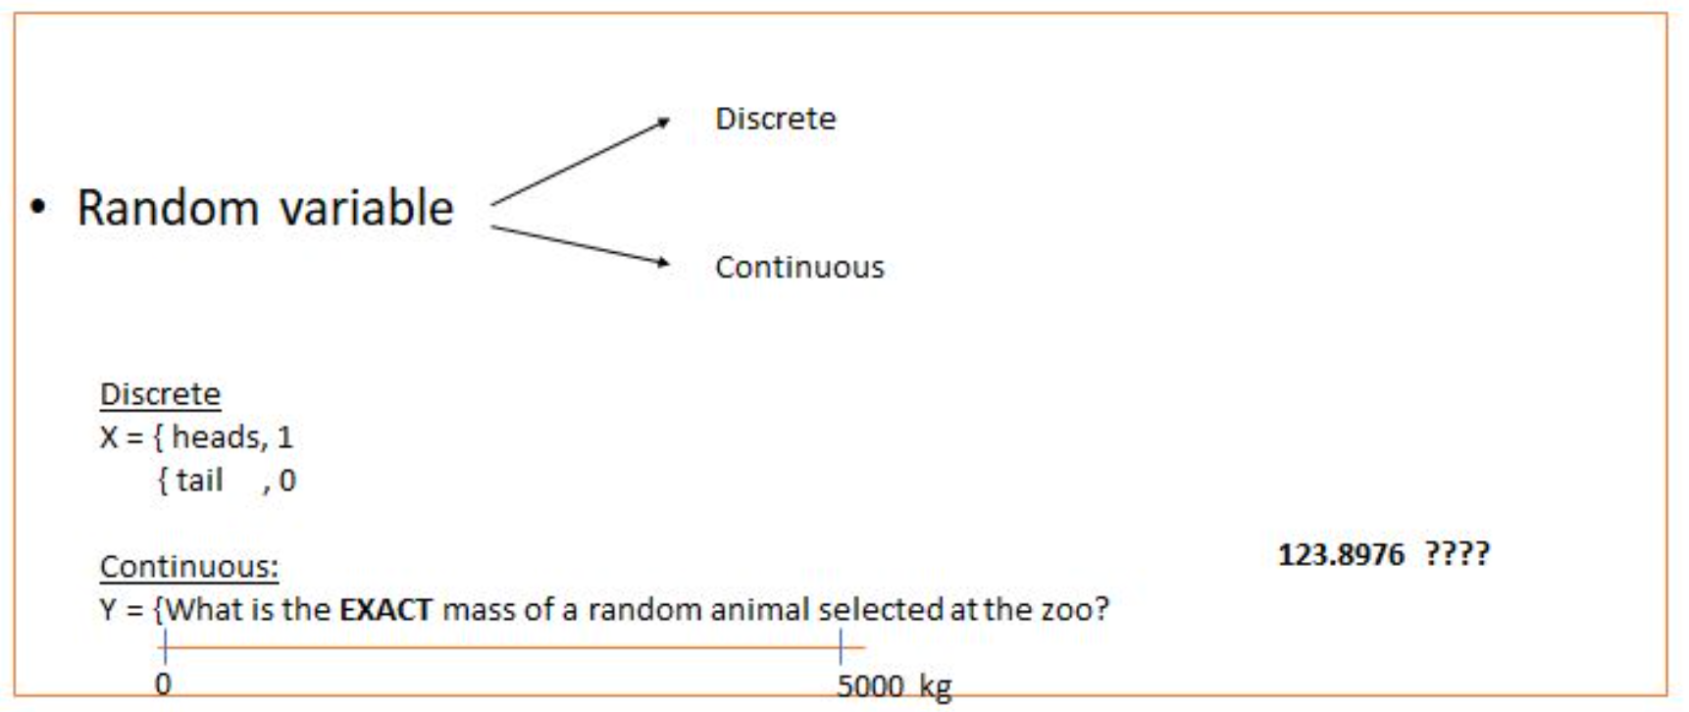
IRONHACK BOOTCAMP
RANDOM VARIABLES:

Slide 3
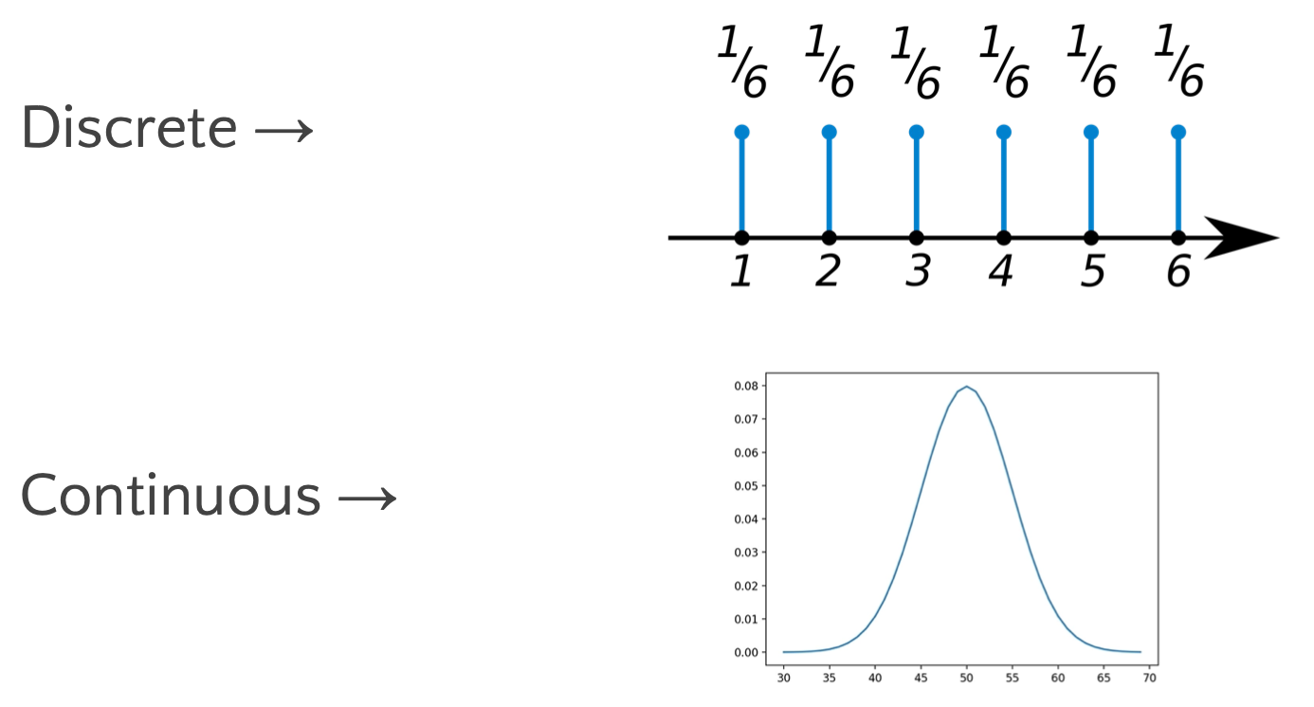
IRONHACK BOOTCAMP
PROBABILITY DISTRIBUTIONS:
Mathematical function that gives us the probabilities of occurrence of different outcomes.
X: temperature
P(X>30)= AUC(X>30)
= int_30^\infty f_X(x)ds
Function f_x is density function
Function F_X(a)=P(X>a) probability distribution function

Slide 4
IRONHACK BOOTCAMP
PMF: PROBABILITY MASS FUNCTION (DISCRETE)
Is a function that give us the probability that a DISCRETE random variable takes an specific value
? taking number bigger 3 in rolling a balanced dice
X: number we get rolling a dice
P(X>3)= P(X=4)+ P(X=5)+P(X=6)= 3 * ⅙= ½
= sum(n >3) P(X=n)
P(X>n) is called distribution function but P(X=n)=⅙ constant (probability mass function)

Slide 5
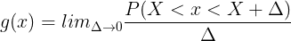
IRONHACK BOOTCAMP
PDF: PROBABILITY DENSITY FUNCTION (CONTINUOUS)
The PDF is the equivalent of PMF but for continuous variables.
As you can have an infinite amount of possible values between any two numbers, is not possible to define the probability for every value.
Therefore, we define a density of probability rather than the probability mass. The concept is very similar to mass density in physics: its unit is probability per unit length. To get a feeling for PDF, consider a continuous random variable X

Slide 6
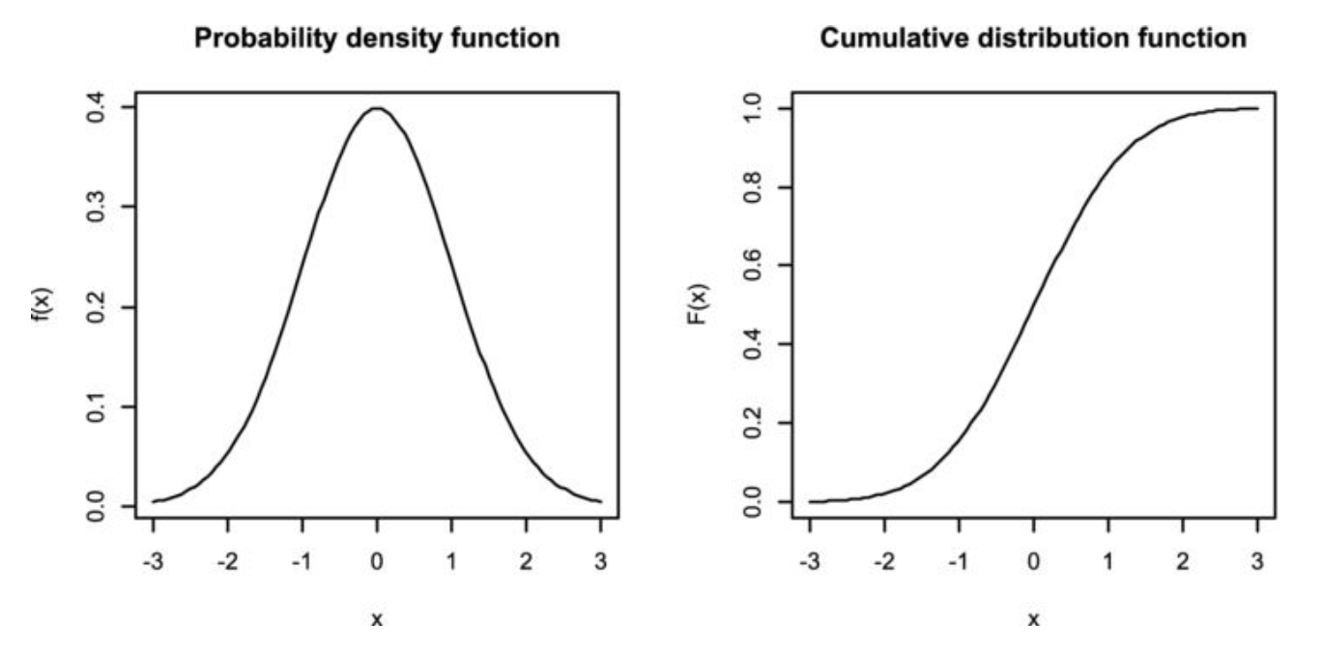
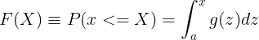
IRONHACK BOOTCAMP
CDF: CUMULATIVE DISTRIBUTION FUNCTION
The CDF is a function that gives the probability of getting any value smaller or equal to a given value:
How much probability we will have if we add probabilities until a given value?

Slide 7

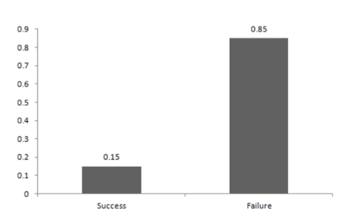
IRONHACK BOOTCAMP
DISCRETE DISTRIBUTIONS: BERNOULLI DISTRIBUTION
A Bernoulli event is one for which the probability the event occurs is p and the probability the event does not occur is 1-p; i.e., the event only has two possible outcomes (usually viewed as success or failure) occurring with probability p and 1-p, respectively
Bag 4 white balls
And 6 black balls
P(black ball)=6/10
P(white ball)= 4/10
X: black ball from the bag
X follows Bernoulli(p) p= 6/10

Slide 8
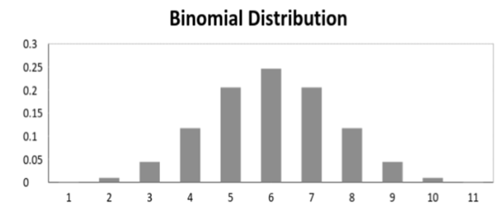
IRONHACK BOOTCAMP
DISCRETE DISTRIBUTIONS: BINOMIAL DISTRIBUTION
When ”n” independent Bernoulli's experiments are conducted, it gives rise to a binomial distribution. Each of the n experiments is either a success or a failure with a probability of success p.
coin launched n times example with x heads.
Coin 10 times biased p(heads)= ⅓
X: getting heads in 10 experiments
P(X=4)= “we have choose 4 heads from these 10” * (1/3)*(1/3)*(1/3)*(1/3)* (2/3)^6
Binomial(n,p): n=10, p=1/3

Slide 9
X: number clicks on a webpage that you enter your customers to enter for ads purpose (you win money if people click)
Plot like in https://en.wikipedia.org/wiki/Poisson_distribution#/media/File:Poisson_pmf.svg
Plot explains number clicks on the page; you collected data and now you know in one month how many clicks you had in intervals hours. If you guess that this distribution is Poisson you are very lucky because you can calculate the avg number clicks per hour (not empirically and this makes you free of not having enough data) is the parameter lambda
How to find lambda? The technology you use is Hypothesis testing (next episode)
Example of why prob distributions matter
If you get 1 eur per click and the avg number clicks is lambda then you will receive 1*lambda euros. Eg lambda =10000 (Hypothesis testing)

Slide 10
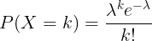
IRONHACK BOOTCAMP
DISCRETE DISTRIBUTIONS: POISSON DISTRIBUTION
The Poisson distribution is used when computing the probability of a k number (integer value [0, ∞]) of events ( counts ), and it’s given by:
In general the Poisson distribution for DISCRETE variables
The possible number of outcomes is unlimited! (Binomial only has a finite amount of possible outcomes).
Is used when we model counting events that can have any values:
Cars arriving a toll per hour
Clients on a cashier queue per hour.

Slide 11
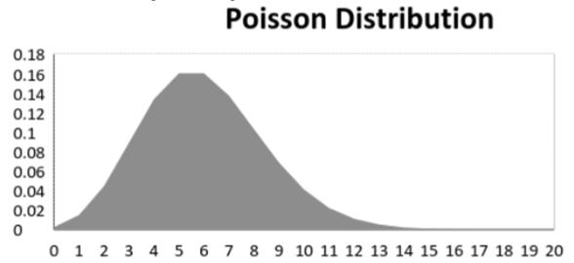
IRONHACK BOOTCAMP
DISCRETE DISTRIBUTIONS: POISSON DISTRIBUTION
The Poisson distribution is used when computing the probability of a k n
p
Possible outcomes x=0,1,2,34,5,

Slide 12
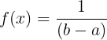
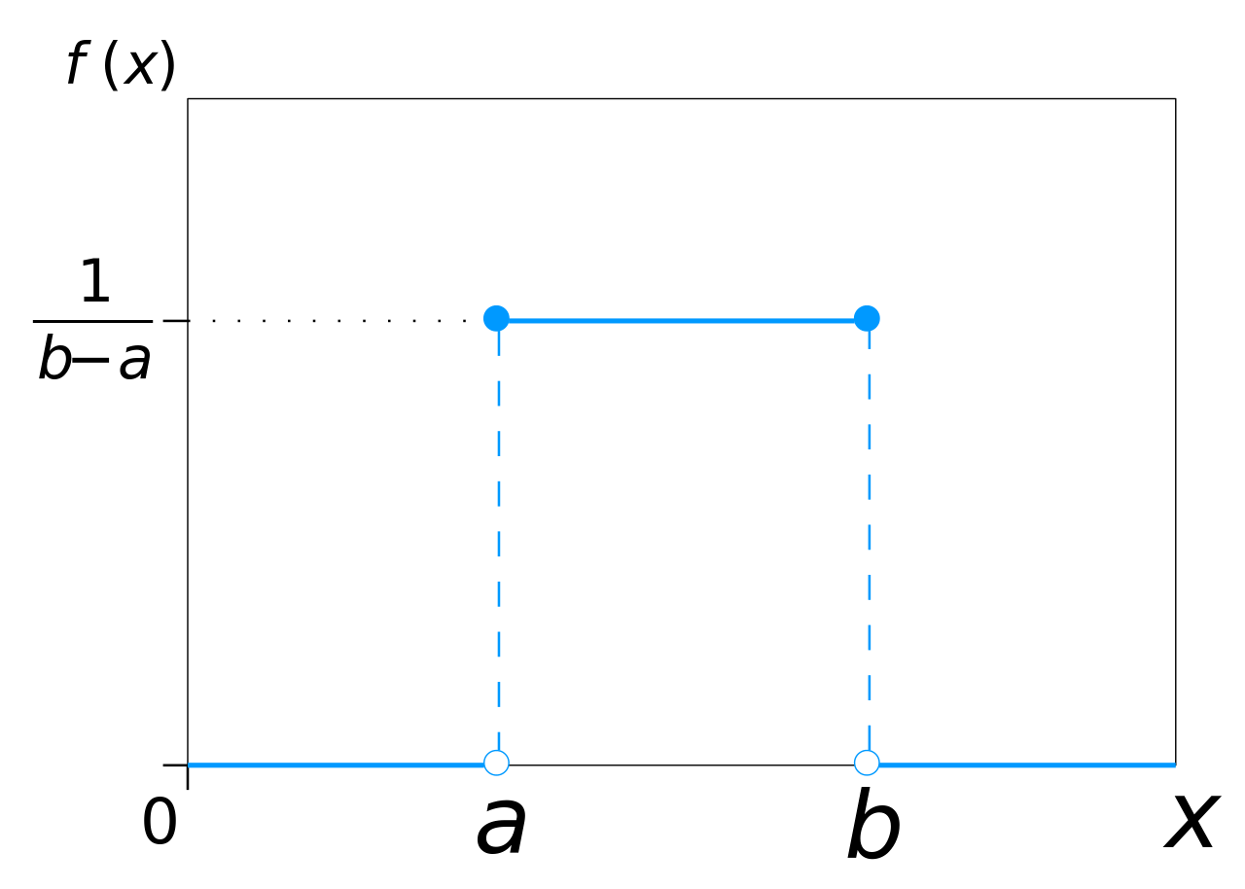
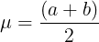
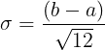
IRONHACK BOOTCAMP
CONTINUOUS DISTRIBUTIONS: UNIFORM DISTRIBUTION
For this distribution, all the values have the same probability to appear.
The uniform distribution is characterized by being constant:
P(a,b)= (b-a)/x

Slide 13
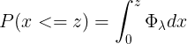
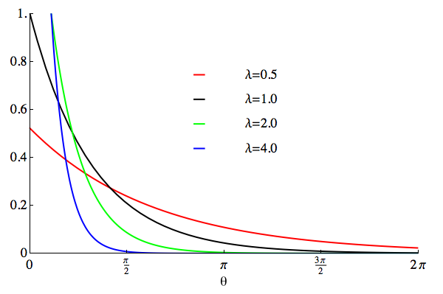
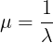
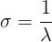
IRONHACK BOOTCAMP
CONTINUOUS DISTRIBUTIONS: EXPONENTIAL DISTRIBUTION
Poisson(lambda)
Lambda: param that counts the rate cars per hour coming to my street
The exponential distribution has the following pdf:
It has the following range of values: [0,inf)
X: time between 2 cars coming into my street

Slide 14
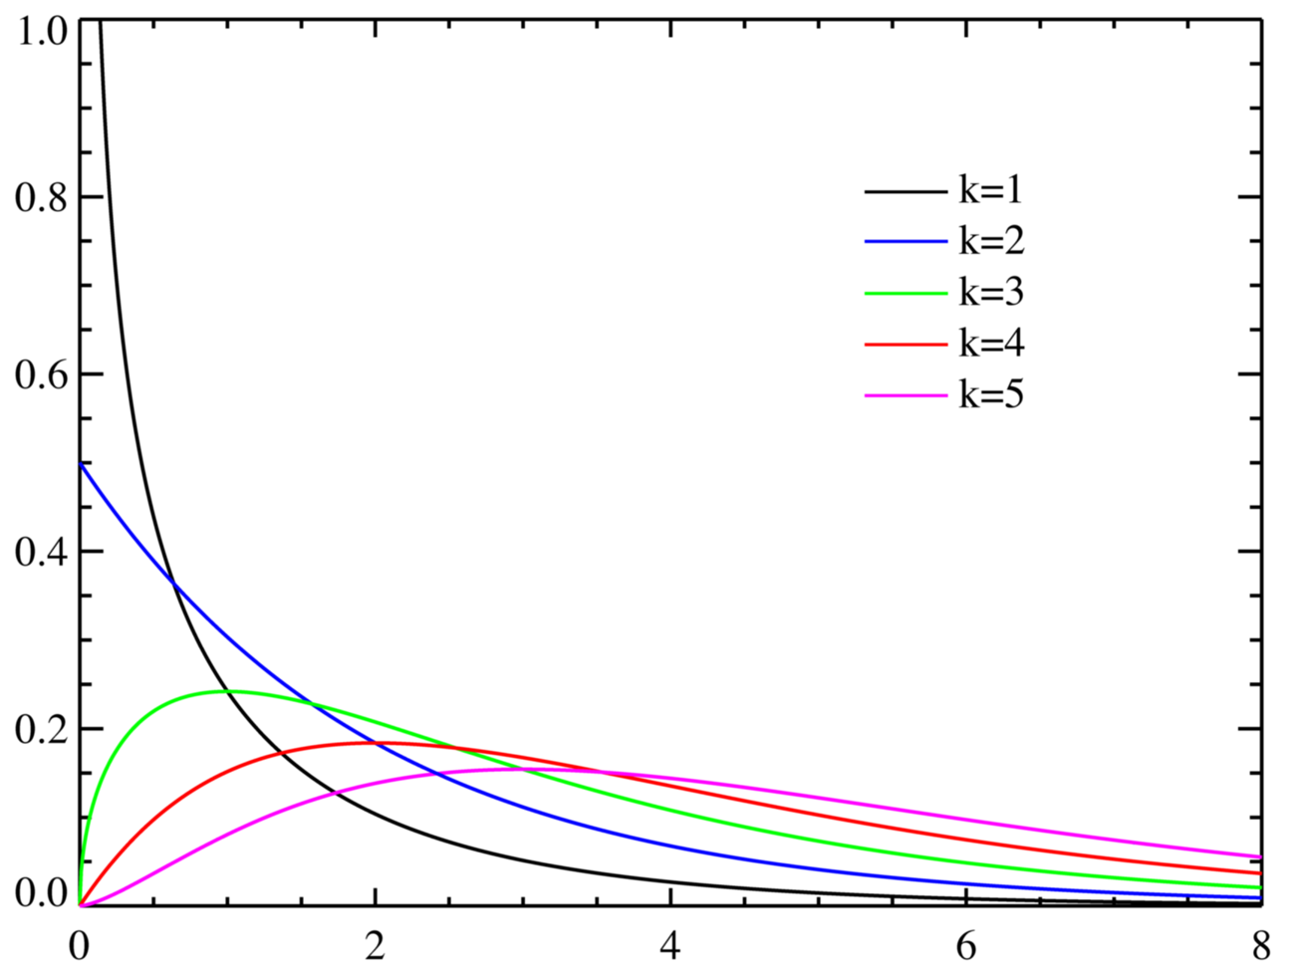
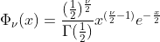
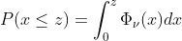
IRONHACK BOOTCAMP
CHI2 DISTRIBUTION
It has the following range of values: [0,inf)

Slide 15
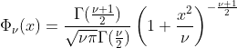
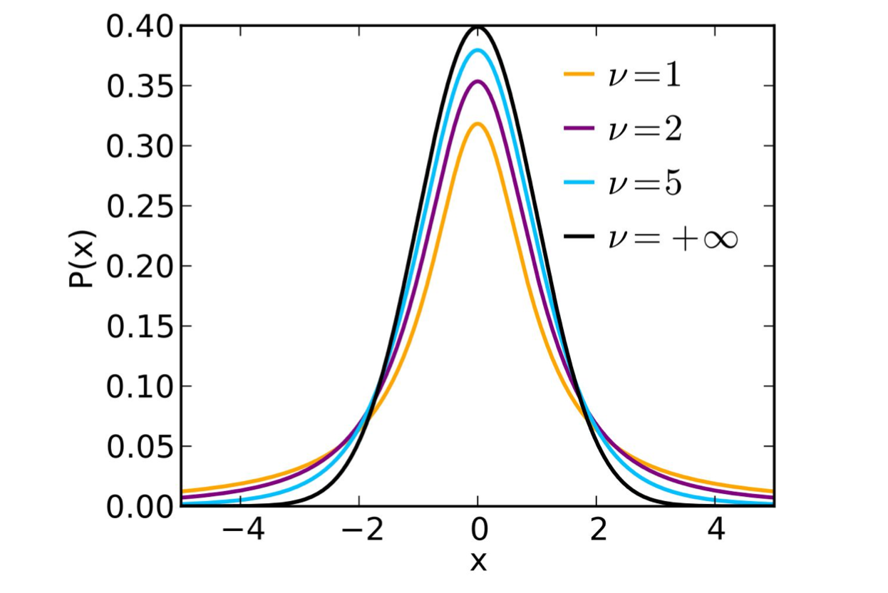
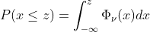
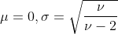
IRONHACK BOOTCAMP
T-STUDENT DISTRIBUTION

Slide 16
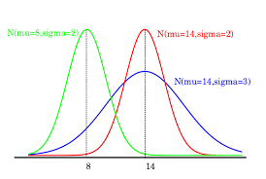
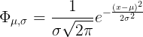
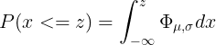
IRONHACK BOOTCAMP
NORMAL DISTRIBUTION
The normal distribution is characterized by the mean and the standard deviation.
X can take values from (-inf,inf)

Slide 17

IRONHACK BOOTCAMP
PROBABILITIES IN PYTHON: SCIPY
Scipy library contains the module ‘stats’ which allows you to compute probabilities, PDF, CDF,....for several distributions.
Official documentation
scipy.stats.norm.pmf()
scipy.stats.norm.ppf() -> what is the value on the x-axis which corresponds to a given area under the curve
scipy.stats.norm.cdf() ->
scipy.stats.expon.pmf()
Every distribution has his own pmf() function in scipy.

Slide 18
Sampling distributions
DATA ANALYTICS | IRONHACK

Slide 19
IRONHACK BOOTCAMP
POPULATION, SAMPLE AND COLLECTION OF SAMPLES
A population can be characterized by a distribution which will have:
A sample drawn from a population will be characterized by a sample mean (changes from sample to sample; is a random variable), and a sample standard deviation:
We can analyze what mean we will get if we compute the mean of the means of many collected samples from the population (sampling distribution):

Slide 20
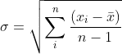
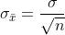
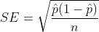
IRONHACK BOOTCAMP
CENTRAL LIMIT THEOREM AND SOME DEFINITIONS:
If the size of a sample n >= 30, the sampling distribution ( distribution of the means of many samples ) will follow a normal distribution, regardless of the original population distribution.
The standard deviation of the sample is:
The standard error of the mean (SEM) is:
For proportions the SE is defined as:

Slide 21
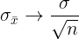
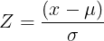
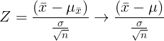
IRONHACK BOOTCAMP
LAW OF LARGE NUMBERS
If the size of a sample n increases a lot, then:
We define Z as:
For a the distribution of many samples (sampling distribution):

Slide 22


